Slide 1
Materiais de Capacitação App Innovation | Cloud Infrastructure
Fabio Hara | @fabiohara PMM | Cloud Infrastructure | App Innovation | Communities

Slide 2
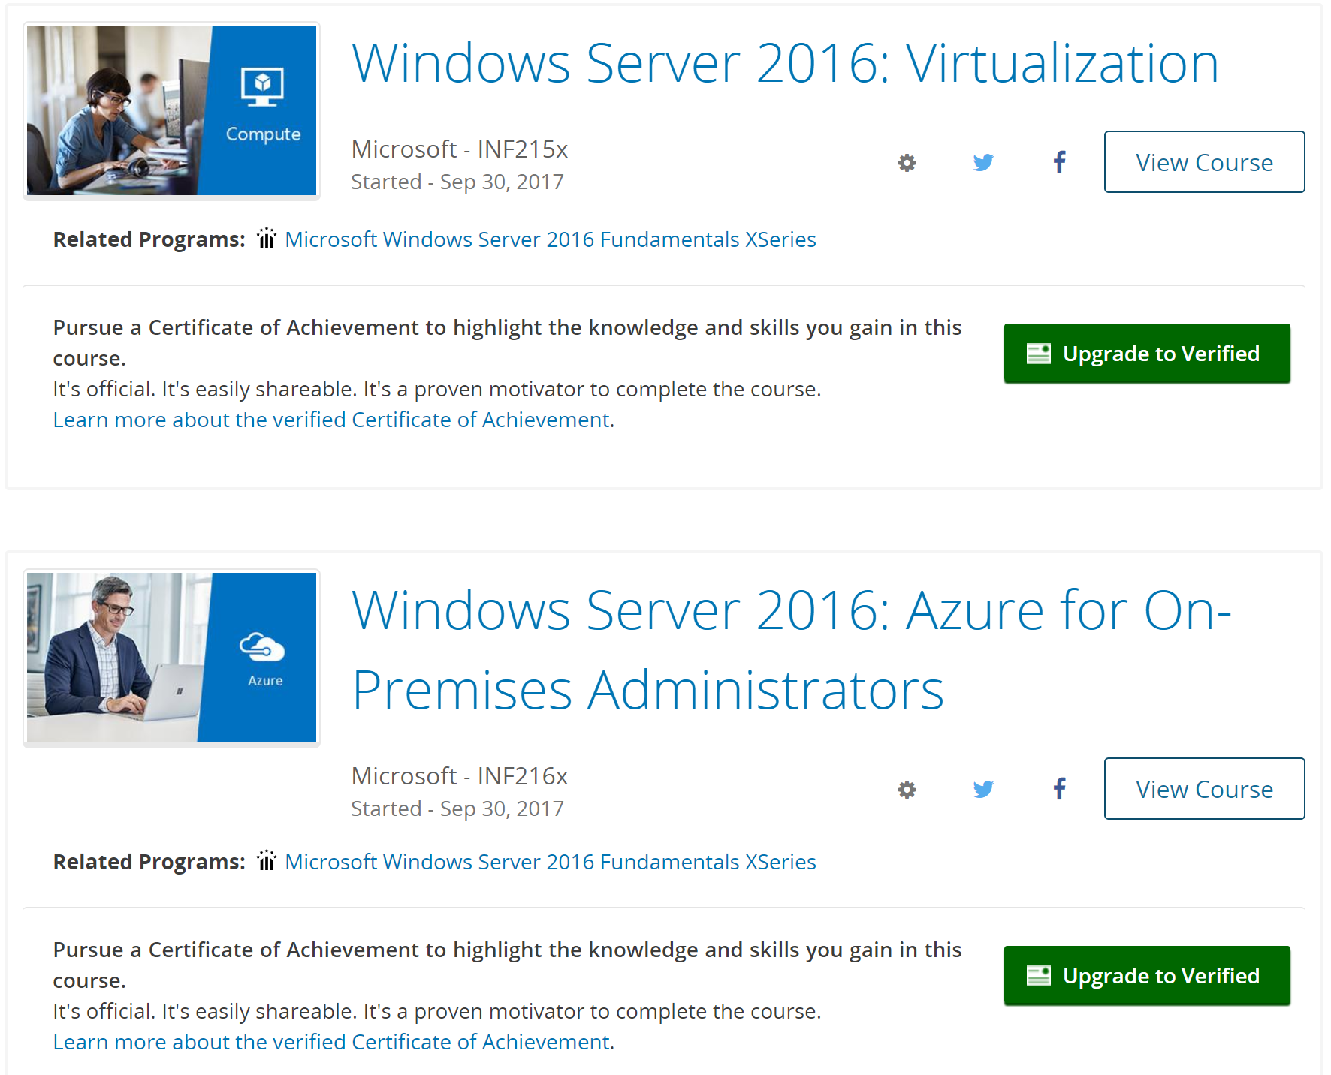
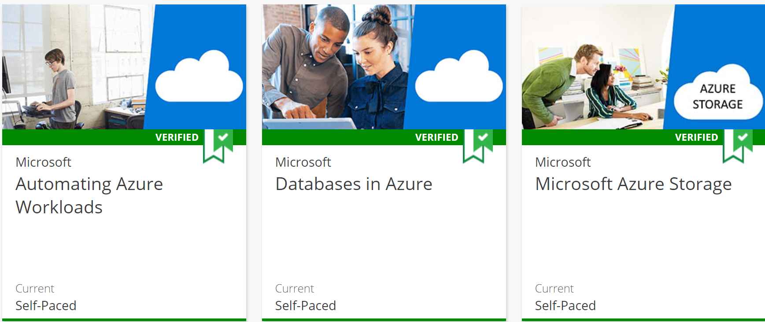
Edx.org
Cursos desenvolvidos em parceria com a Microsoft
100% online e gratuito
Laboratórios práticos (inclusive Azure) com exames
Certificados de conclusão podem ser emitidos após conclusão (U$99) – não é obrigatório
Instrutores funcionários da Microsoft
Mesmo material de treinamento para times técnicos da Microsoft

Slide 3
Windows Server 2016 | System Center 2016
Windows Server 2016: Infrastructure
https://www.edx.org/course/windows-server-2016-infrastructure-microsoft-inf211x-0
Windows Server 2016: Directory Services
https://www.edx.org/course/windows-server-2016-directory-services-microsoft-inf212x-0
Windows Server 2016: Basic Storage
https://www.edx.org/course/windows-server-2016-basic-storage-microsoft-inf213x-0
Windows Server 2016: Basic Networking
https://www.edx.org/course/windows-server-2016-basic-networking-microsoft-inf214x-0
Windows Server 2016: Virtualization (inclui Windows Containers)
https://www.edx.org/course/windows-server-2016-virtualization-microsoft-inf215x-0
Windows Server 2016: Azure for On-Premises Administrators
https://www.edx.org/course/windows-server-2016-azure-premises-microsoft-inf216x-0
System Center 2016: Building a Datacenter Fabric
https://www.edx.org/course/system-center-2016-building-datacenter-microsoft-inf262x

Slide 4
Visual Studio | VSTS | DevOps
Introduction to DevOps
https://www.edx.org/course/introduction-devops-microsoft-dev212x-3
DevOps for Databases
https://www.edx.org/course/devops-databases-microsoft-devops200-6x
Introduction to DevOps Practices
https://www.edx.org/course/introduction-devops-practices-microsoft-devops200-1x
DevOps Testing
https://www.edx.org/course/devops-testing-microsoft-devops200-5x
Continuous Integration and Continuous Deployment
https://www.edx.org/course/continuous-integration-continuous-microsoft-devops200-3x
DevOps for Mobile Apps
https://www.edx.org/course/devops-mobile-apps-microsoft-devops200-8x
Infrastructure as Code
https://www.edx.org/course/infrastructure-code-microsoft-devops200-2x
Configuration Management for Containerized Delivery
https://www.edx.org/course/configuration-management-containerized-microsoft-devops200-4x
Microsoft Professional Capstone: DevOps
https://www.edx.org/course/microsoft-professional-capstone-devops-microsoft-devops200-10x
Application Monitoring and Feedback Loops
https://www.edx.org/course/application-monitoring-feedback-loops-microsoft-devops200-7x

Slide 5
Containers
Windows Server 2016: Virtualization (inclui Windows Containers)
https://www.edx.org/course/windows-server-2016-virtualization-microsoft-inf215x-0
Introduction to Kubernetes
https://www.edx.org/course/introduction-kubernetes-linuxfoundationx-lfs158x
Fundamentals of Containers, Kubernetes, and Red Hat OpenShift
https://www.edx.org/course/fundamentals-containers-kubernetes-red-hat-do081x

Slide 6
Azure | Infrastructure | OMS
Microsoft Azure Virtual Machines
https://www.edx.org/course/microsoft-azure-virtual-machines-microsoft-azure202x-0
Microsoft Azure Virtual Networks
https://www.edx.org/course/microsoft-azure-virtual-networks-microsoft-azure203x
Microsoft Azure Storage
https://www.edx.org/course/microsoft-azure-storage-microsoft-azure205x
Automating Azure Workloads
https://www.edx.org/course/automating-azure-workloads-microsoft-azure210x
Azure Security and Compliance
https://www.edx.org/course/azure-security-compliance-microsoft-azure208x
Configuration Management for Containerized Delivery
https://www.edx.org/course/configuration-management-containerized-microsoft-devops200-4x
Architecting Microsoft Azure Solutions
https://www.edx.org/course/architecting-microsoft-azure-solutions-microsoft-dev205bx-4
Migrating Workloads to Azure
https://www.edx.org/course/migrating-workloads-azure-microsoft-azure212x
Microsoft Professional Orientation: Cloud Administration
https://www.edx.org/course/microsoft-professional-orientation-cloud-microsoft-azure215x
Application Monitoring and Feedback Loops (inclui OMS)
https://www.edx.org/course/application-monitoring-feedback-loops-microsoft-devops200-7x#!

Slide 7
Recap aka.ms/aprendaws2016 aka.ms/aprendadevops aka.ms/azureinfra

